Slide 1



Slide 2

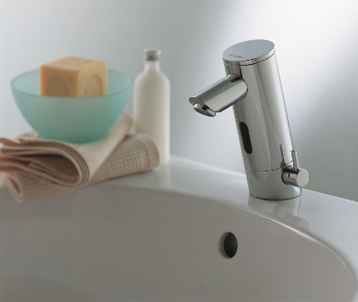
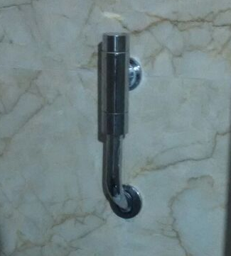
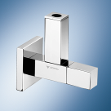
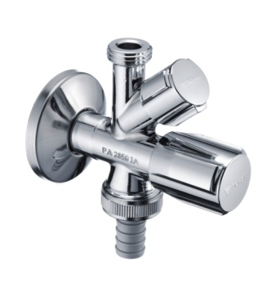
Sanitary draw-off taps
Wash basin draw-off taps
Wall-mounted draw-off taps
Shower fittings
WC and urinal flush
Concealed flush valves
Exposed flush valves
Mounting modules
Appliance connection fittings
Draw-off taps
Appliance valves
Safety fittings
Angle valves
Design angle valves
Special angle valves
Copper pipes / flexible hoses

Slide 3
WC flush valve COMPACT II ND
01 137 00 99
WC flush valve COMPACT II
01 194 00 99
Mechanical actuation only
Water path DR brass
Noise class I & II
Inbuilt isolation ball valve
Universal box for all WC control
Cover in POM box.
Construction plugh

Slide 4
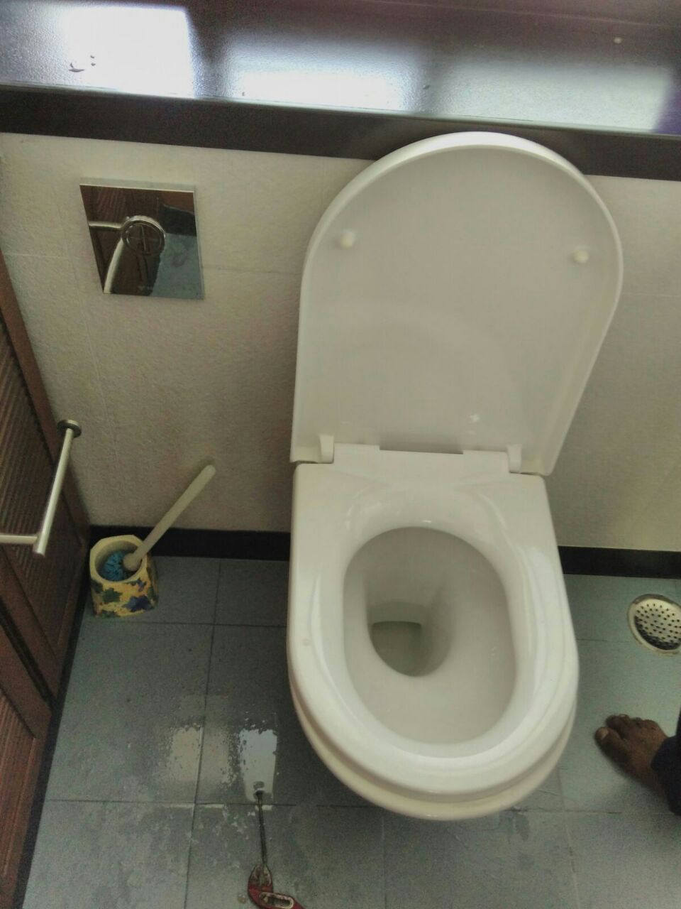
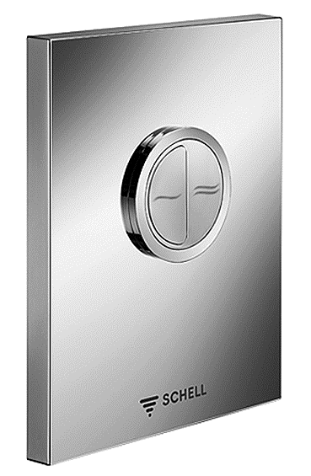
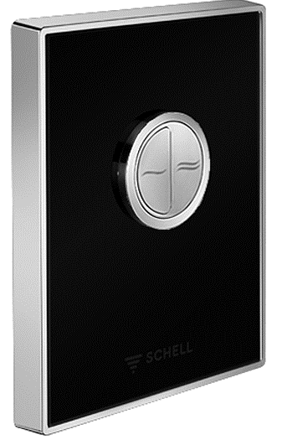
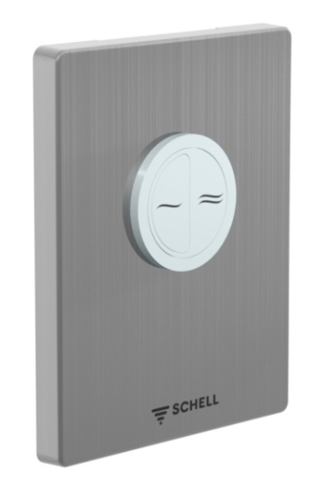
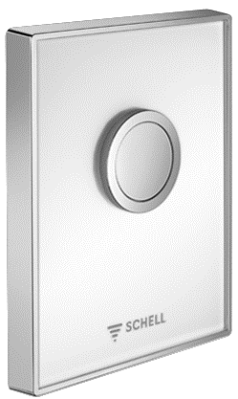
ABS CHROME PLATE
BLACK GLASS PLATE
Stainless steel Plate
White Glass Plate

Slide 5
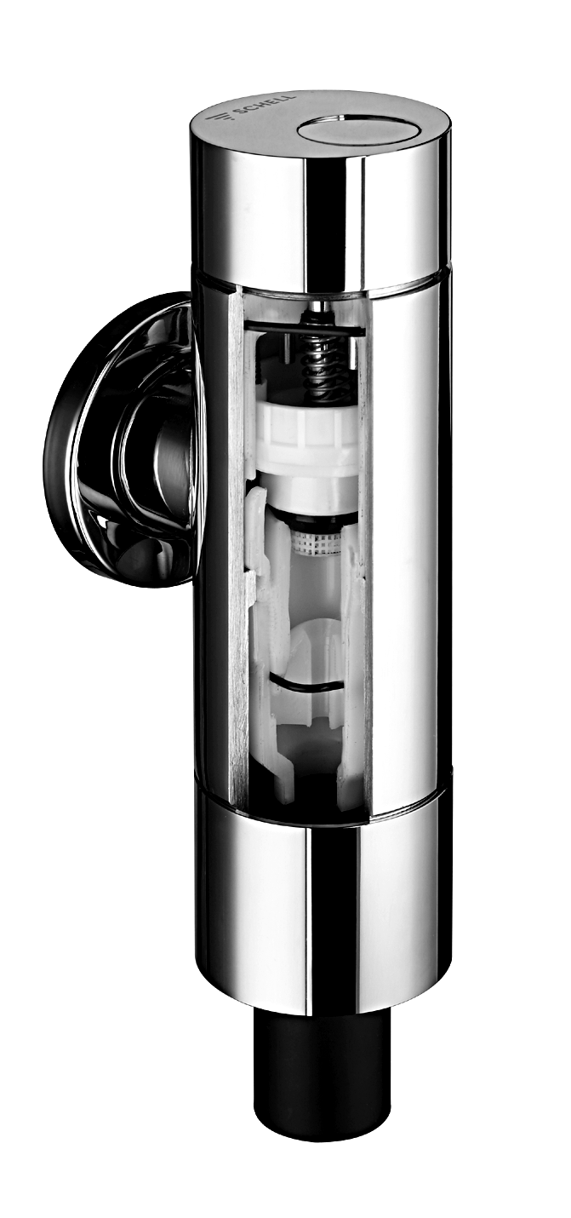
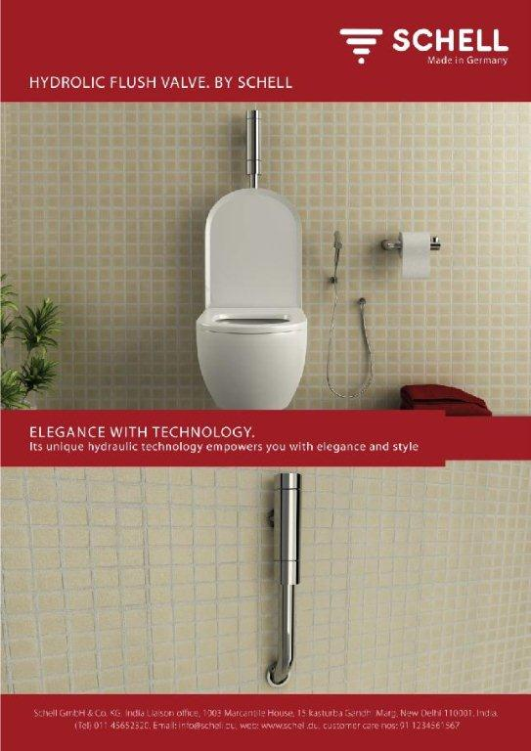
Best for small wall depth
Choice of placement on left or right.
New development of threaded collar.
Suitable for wall to wall toilets
Robust
Using the pressure button
The support valve opened. Water follows through the relief well out of the back pressure chamber. In the back pressure chamber the pressure is going down.
Flush
The higher water pressure under the piston lift this up. Thus the main valve is lifted and water flows.
Closing operation
The support valve is closing and the water flows through the relief well in the upper back pressure chamber. The pressure over and under the piston gets the same level. The area over the piston is bigger than below. Thus a higher force is acting and the main valve is closing. The water pressure over and under the piston are the same now.

Slide 6
Why Schell Flush Valve?
Dual Flush manual option/Sensor Flush
Main flush adjustable 4.5 lit to 9 lit @ 3 bar
Touch free with dual flush @ time
Multiple actuation plate position in sensor
Sustainable
Hygienic
Long lasting
Battery or Mains
Inbuilt stop valve or isolation valve
Complete set is available
Height adjustment is possible
Water saving

Slide 7
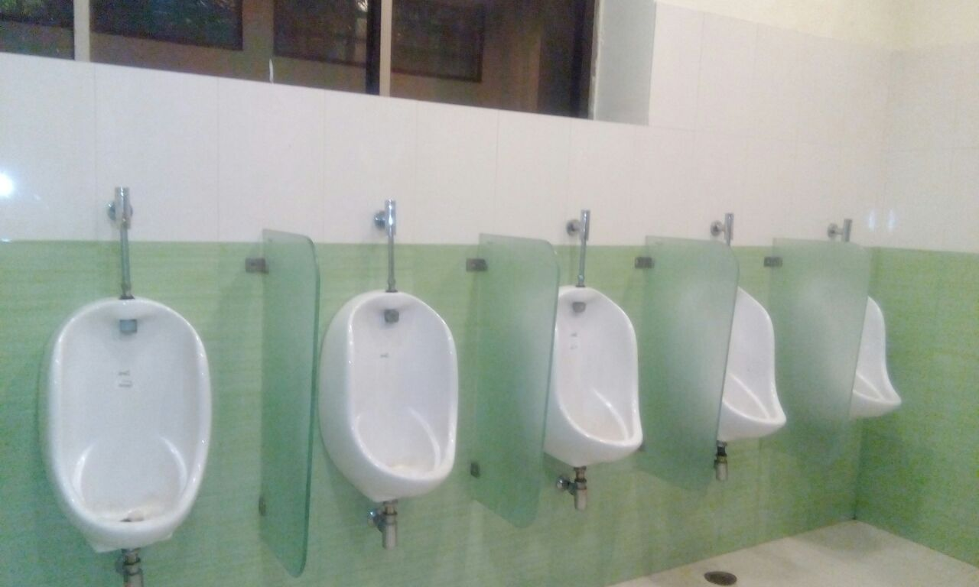
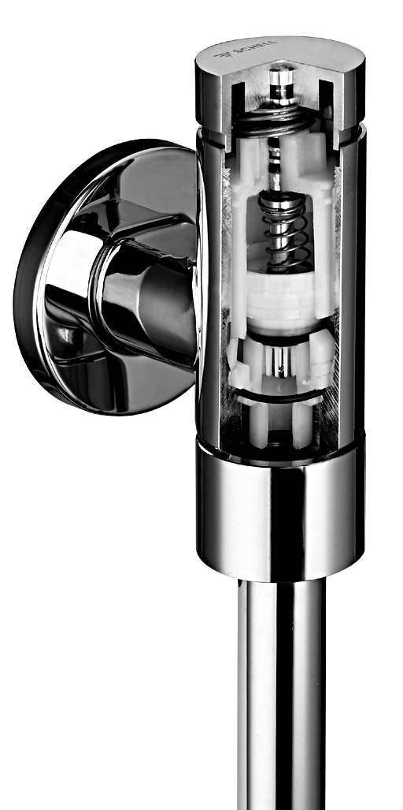
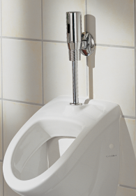
Electronic urinal flush control
EXPOSED TOP INLET MANULA URINAL
SCHELLTRONIC
WC- and urinal- cartridges in high quality
Precise working during the production
Excellent mechanical seal (even against particles)
Fluidic optimised behaviour (
Stable flow time
Long life material
High resistance against carbonat due to low roughness of the surface
Infrared sensoric
Unique design
Surface polsihed chromed
Sensor window plastic
Perfect for renovating
Tap splashproof
Isolating valve
Stagnation flush 24 hours after last use

Slide 8
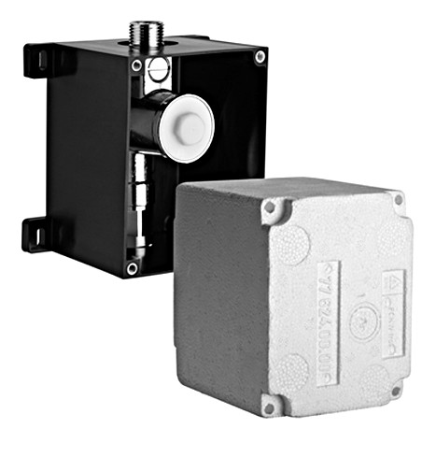
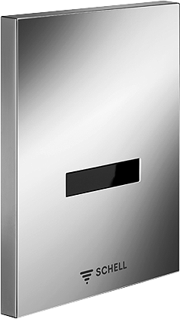
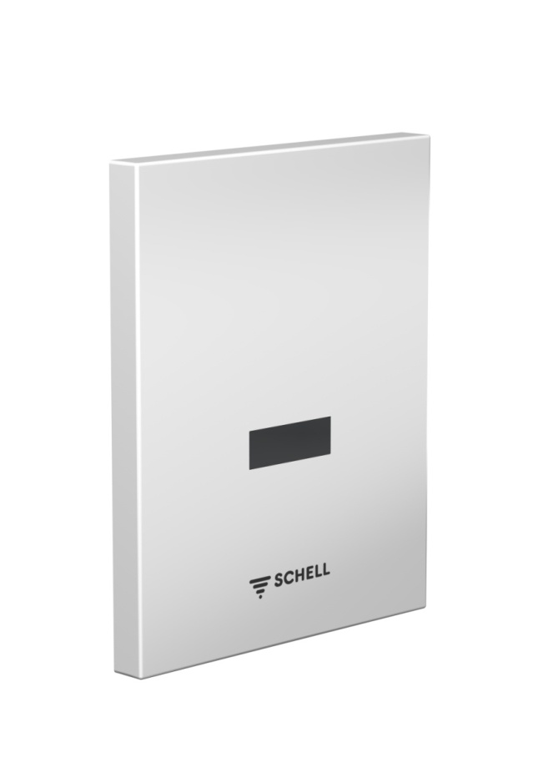
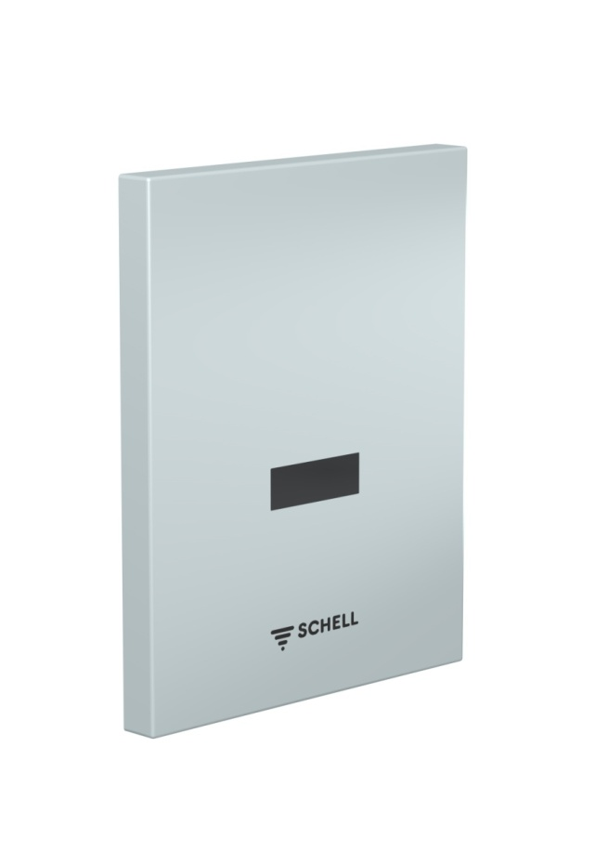
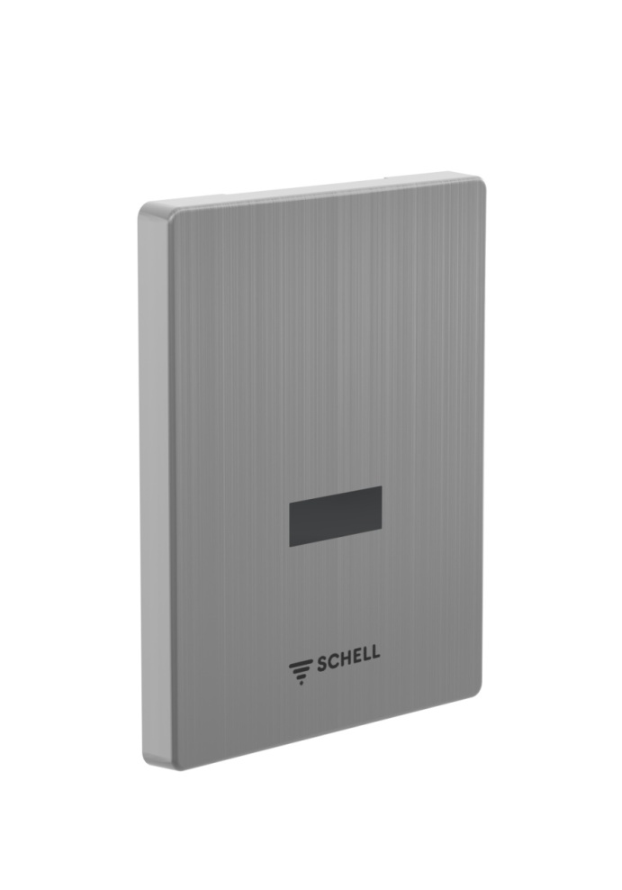
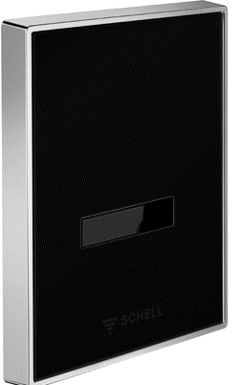
Material: ABS
Surface: White
Material: ABS
Surface: Chrome
Mechanical or electronic actuation
Water path DIN EN brass
Low noise approved
One box for all urinal control button EDITION
Infrared sensoric
Power supply
  Main 230 V / 50 Hz
  Battery 9 V
Sensor range adjustable about 500 mm
Flush time adjustable 2 – 15 sec
Stagnation flush 24 hours after last use
Material: Stainless Steel
Surface: Stainless Steel
Material: Glass
Surface: Black

Slide 9
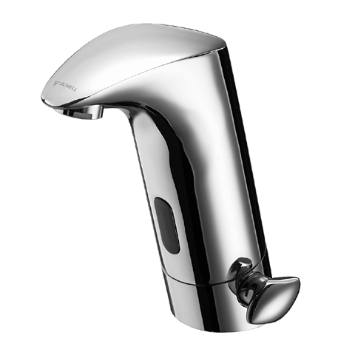
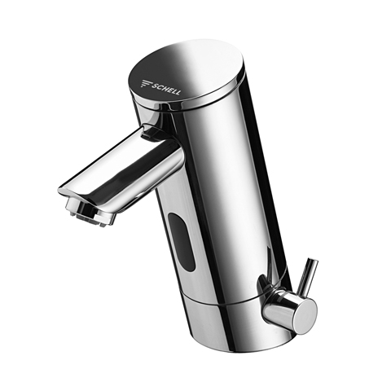
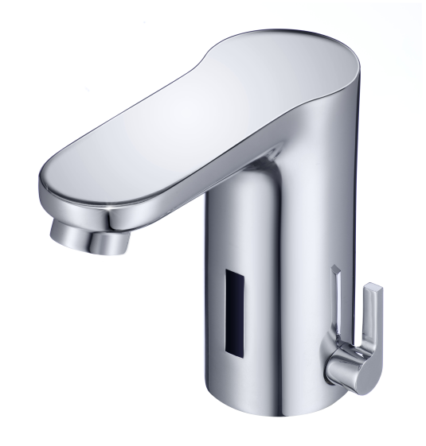
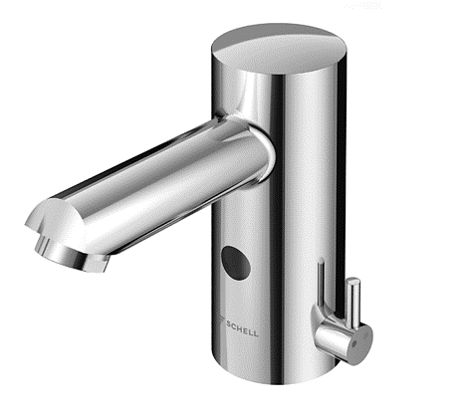
Electronic wash basin taps
Touch free: 100 % hygienical
Saving water:
  flow volume 6 l / min
  runs only when needed
PURIS E
PURIS E
CELIS E

Slide 10
Regulating angle valve
Brass cone compression connection incl. lenght compensation
Grease chamber for ensuring long-lasting ease of movement
Push-fit rosette - flexible for 18 mm
SCHELL COMFORT handle
Faster assembly thanks to self-sealing connection thread (ASAG)
Compression casting plus snap-ring lock ensure double safety to prevent the spindel unscrewing by accident
No lime deposits, maintenance-free due to double O-ring seal

Slide 11
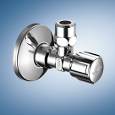
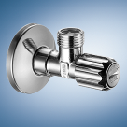
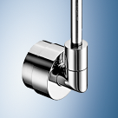
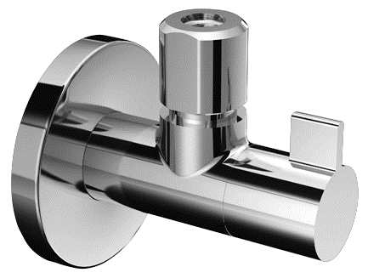

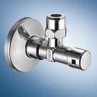
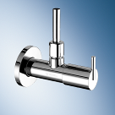
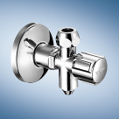
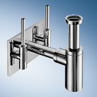
Regulating angle valve
COMFORT
Regulating angle valve
QUAD
inlay on face side out of genuine wood or black glass
with fine filer
Regulating angle valve, additionally
with backflow preventer (BP),
ZOOM
Operation and depth compensation
by brass rosette
with secured operation
Regulating angle valve for protection
against unauthorised use, f. ex. in public buildings
PURIS
Allmetal construction
COMFORT
COMFORT with drain connection
can be drained for protection against frost
EDITION
Design angle valve EDITION Ensemble.
Angle valves, siphon and design panel

Slide 12
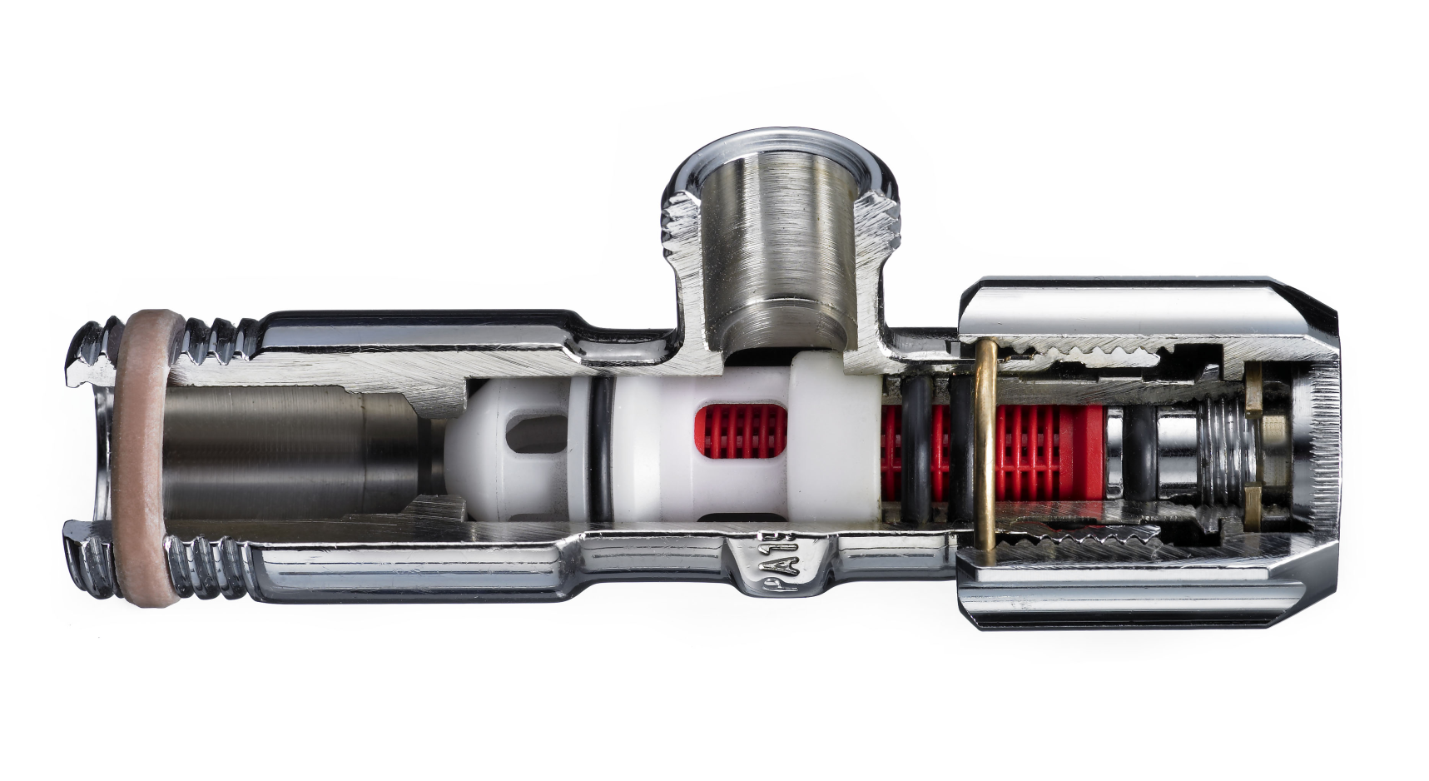
Regulating angle valve
To clean the filter close the angle valve
no central closing necessary!
Angle valve with filter

Slide 13
Thank you for your attention

