Slide 1
JAYANTHI TRADE LINKS- HYD
WELLNESS FOR YOU
We represent leading brands of wellness product manufacturers from Europe & the USA. We bring to you a comprehensive package of wellness products
What we offer:
End to end solutions
Technical support
Local interface with off-shore manufacturers
Option of off-shore supplies invoiced directly from manufacturers
Pre & Post installation supervision
Service Support
Product Lines
HYDRO-MASSAGE SPAS
FITNESS & EXERCISE POOLS
HAMMAM – STEAM ROOMS
SAUNA
OXYGEN-THERAPY BATHS
STEAM MODULES
MULTI-FUNCTION CABINS
EMOTIONAL SHOWERS
ICE FOUNTAINS
FLOATATION BEDS
SALT WALLS
HEATED LOUNGERS
ACRYLIC & ENAMEL STEEL BATHS & WHIRLPOOLS
SPA TVS & VANITY TVS
SHOWERING

Slide 2
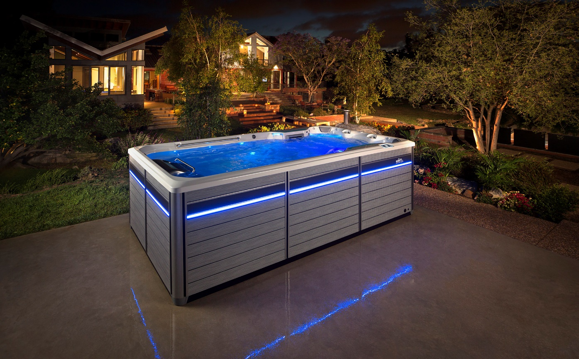
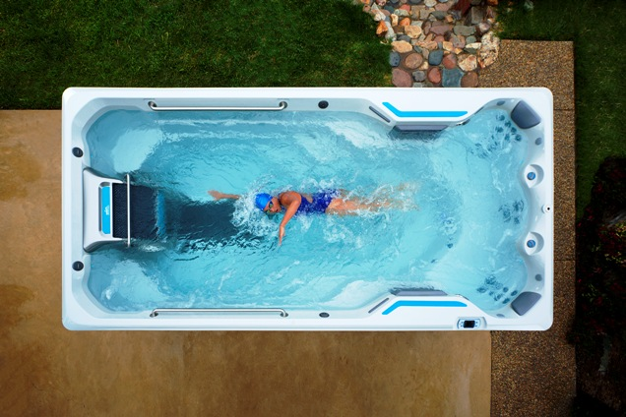
JAYANTHI TRADE LINKS- HYD
ENDLESS POOL FITNESS SPA

Slide 3
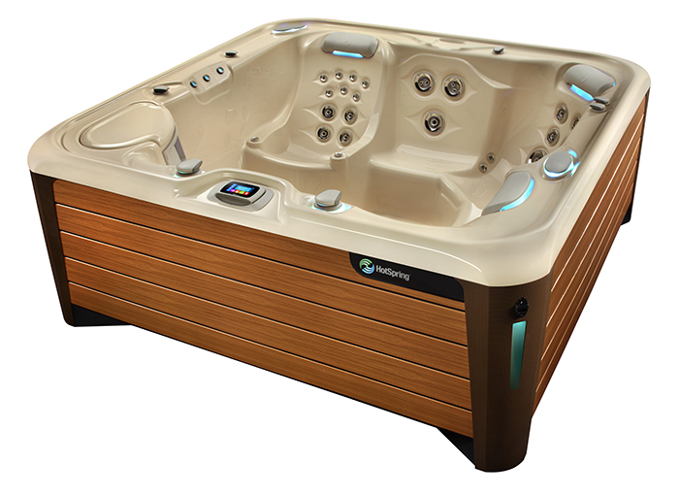
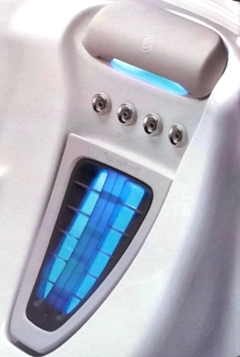
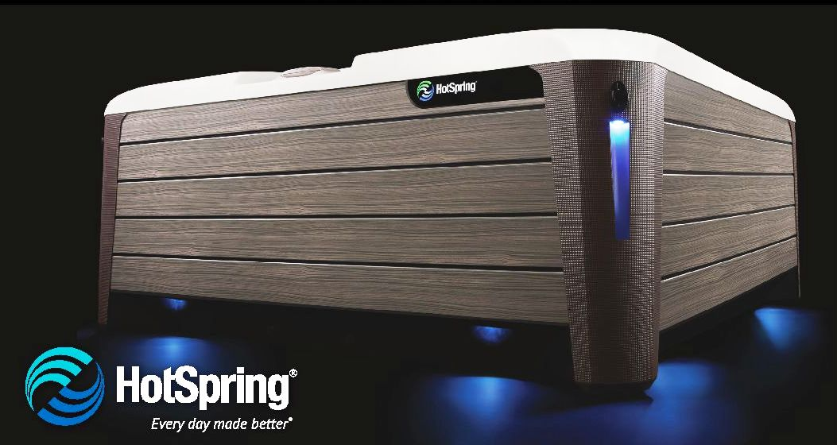
JAYANTHI TRADE LINKS- HYD
HOTSPRING SPA

Slide 4
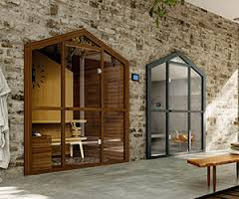
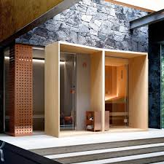
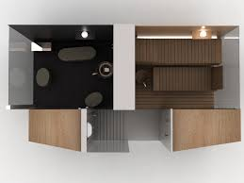
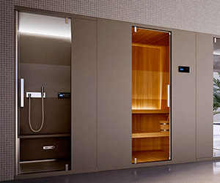
JAYANTHI TRADE LINKS- HYD
SAUNA & HAMMAM COMPOSITIONS

Slide 5

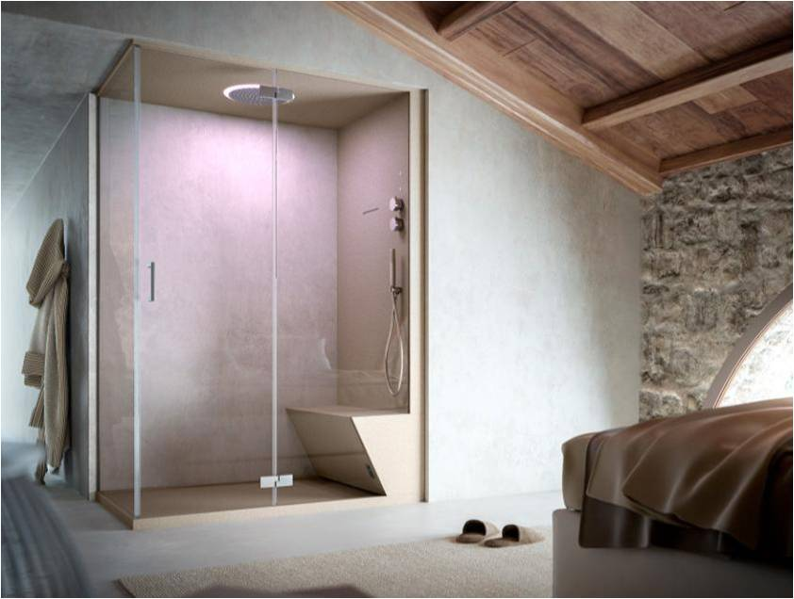
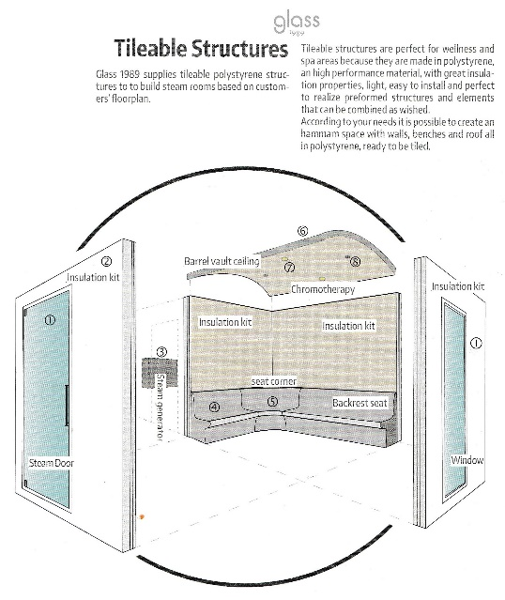
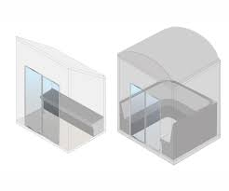
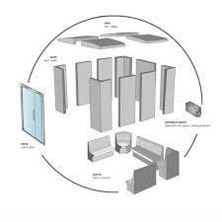
JAYANTHI TRADE LINKS- HYD
HAMMAM

Slide 6
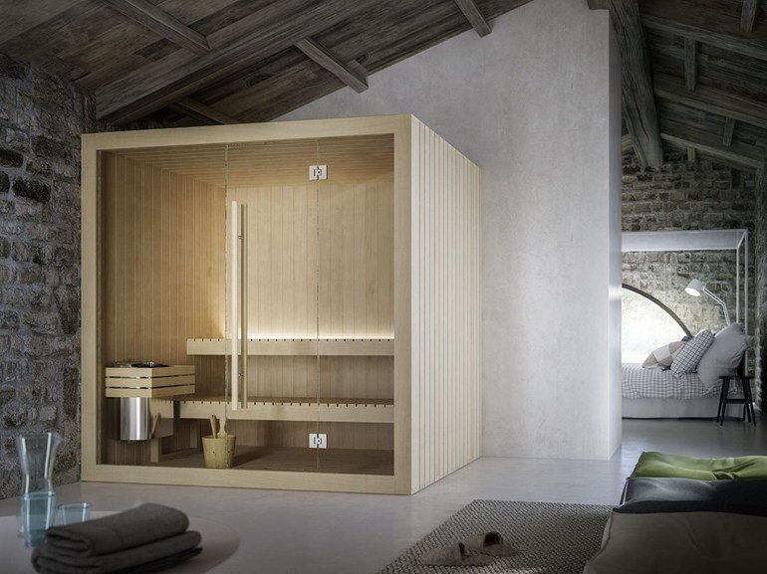
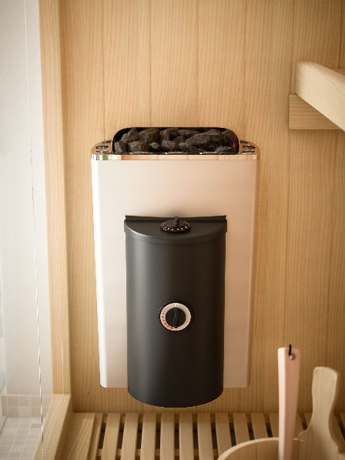
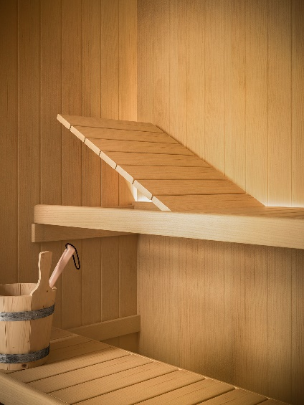
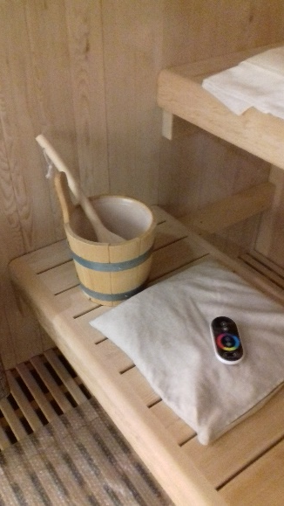
JAYANTHI TRADE LINKS- HYD
SAUNA

Slide 7

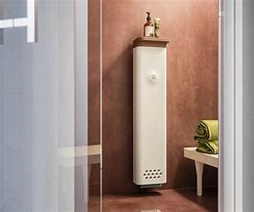

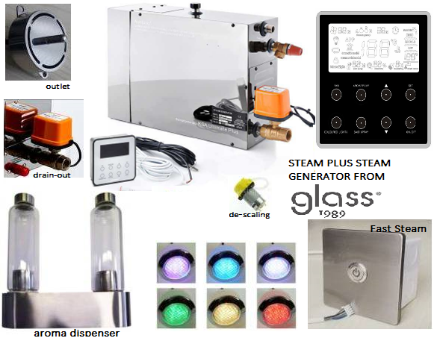
JAYANTHI TRADE LINKS- HYD
STEAM MODULES

Slide 8

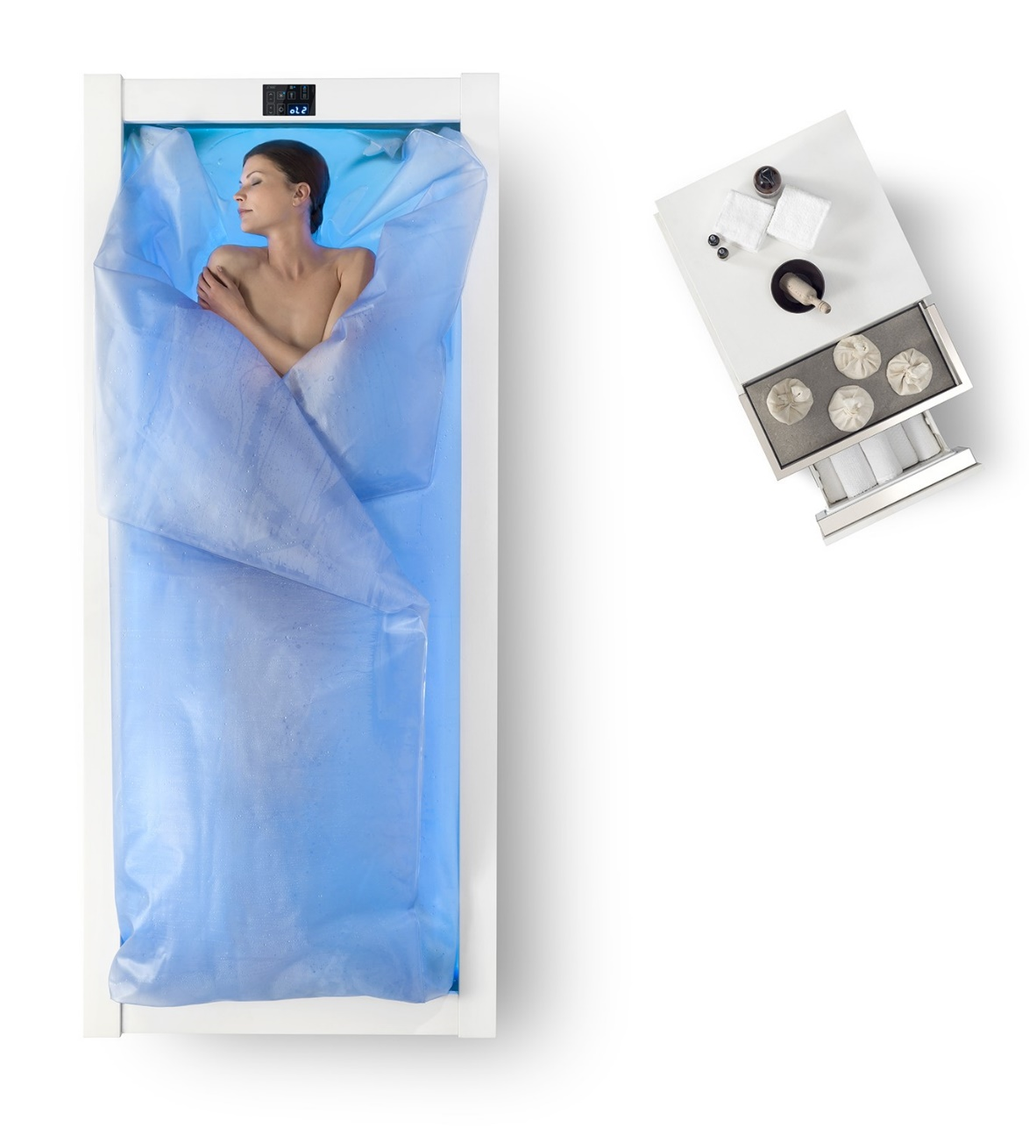

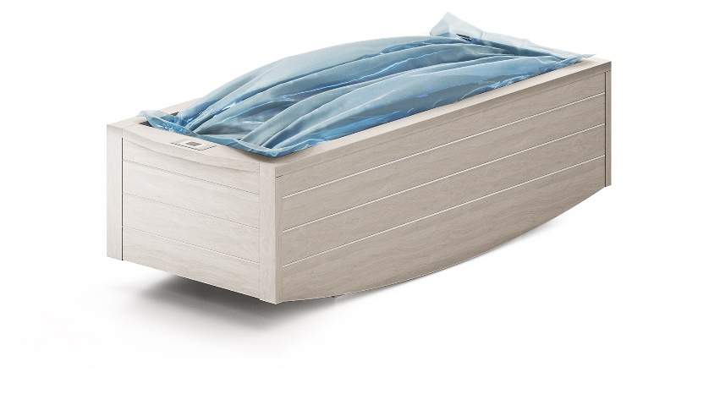
JAYANTHI TRADE LINKS- HYD
FLOATATION BED

Slide 9
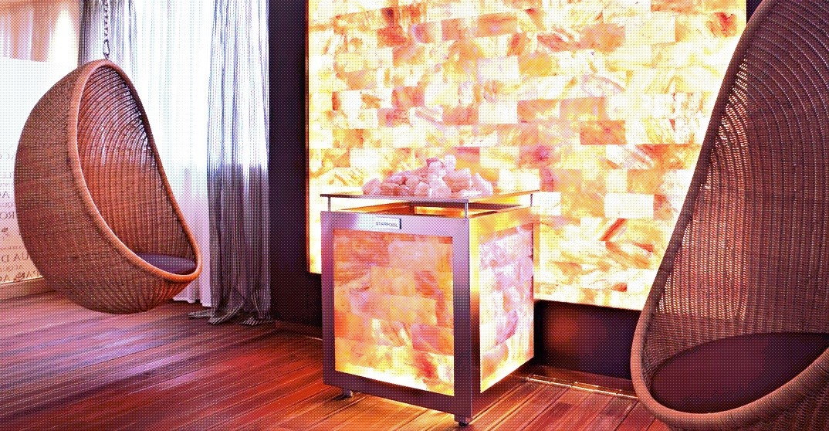
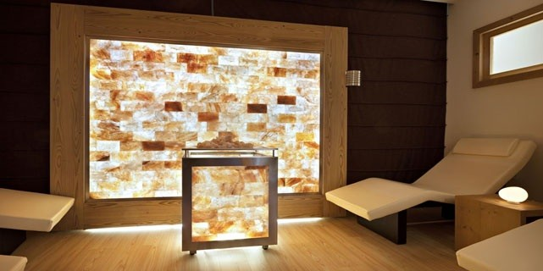
JAYANTHI TRADE LINKS- HYD
SALT WALL

Slide 10
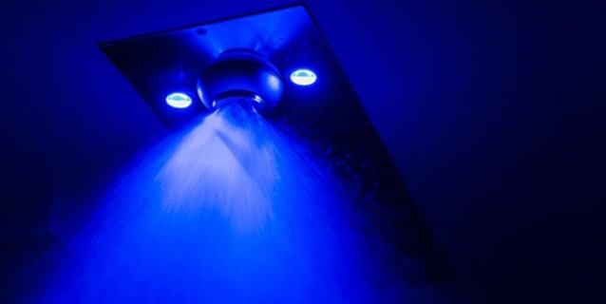
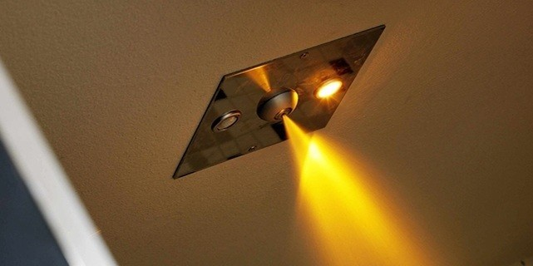
JAYANTHI TRADE LINKS- HYD
SHOWER HEAD – COLD SHOWER & TROPICAL RAIN

Slide 11
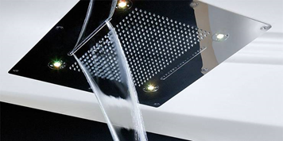

JAYANTHI TRADE LINKS- HYD
EMOTIONAL SHOWER

Slide 12

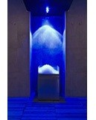
JAYANTHI TRADE LINKS- HYD
ICE FOUNTAIN – CEILING MOUNTED

Slide 13


JAYANTHI TRADE LINKS- HYD
KNIEPP 4 SECTORS WITH JETS
VERTICAL KNIEPP

Slide 14

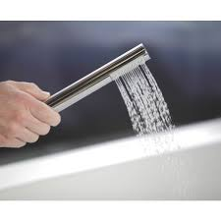
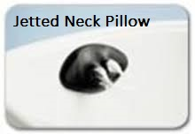

JAYANTHI TRADE LINKS- HYD
MICROSILK OXYGEN RICH BATH

Slide 15
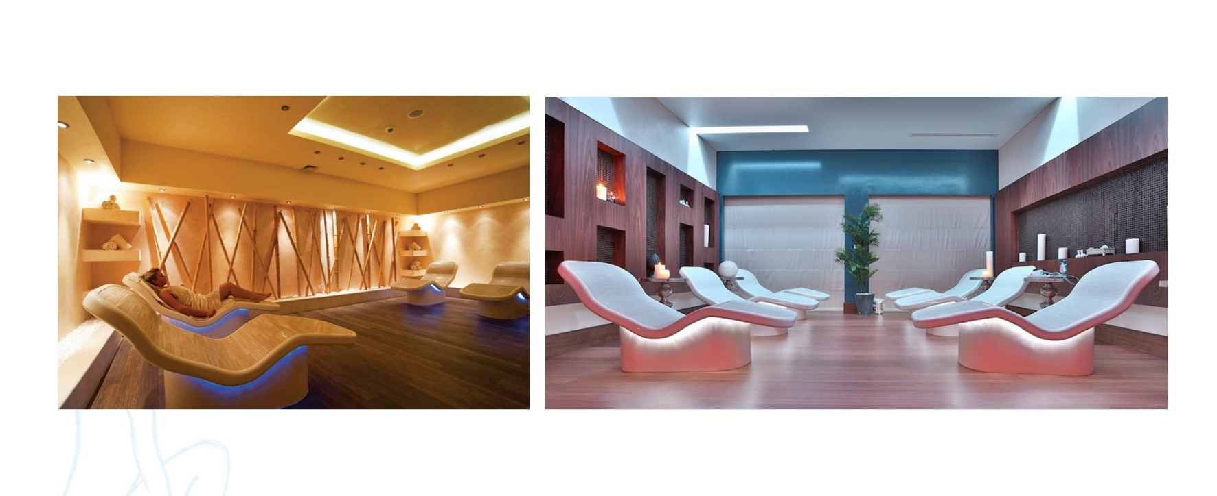
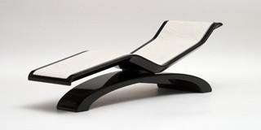
JAYANTHI TRADE LINKS- HYD
SWEET CHAIR RELAX

Slide 16
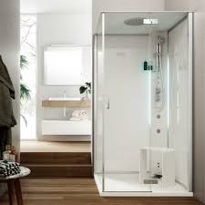


JAYANTHI TRADE LINKS- HYD
MULTI-FUNCTION CABIN

Slide 17
JAYANTHI TRADE LINKS- HYD
CONTACTS
THANK YOU!
JAYANTHI TRADE LINKS-HYD
Flat No.610, Gharonda Seshasai Apt., Vijayapuri Colony,
South Lallaguda, Tarnaka, Secunderabad-500017.
E-mail ID-jayanthitradelinkshyd@yahoo.com
Mobile: 9989532222
Mumbai I Delhi I Bangalore I Hyderabad I Chennai I Kochi

